Slide 1
Control Statements
Control Statements
Decision making / Branching
Looping / Iteration
Jumping

Slide 2


Decision Making / Branching

Slide 3
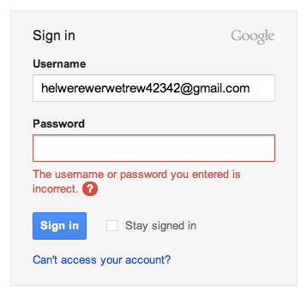
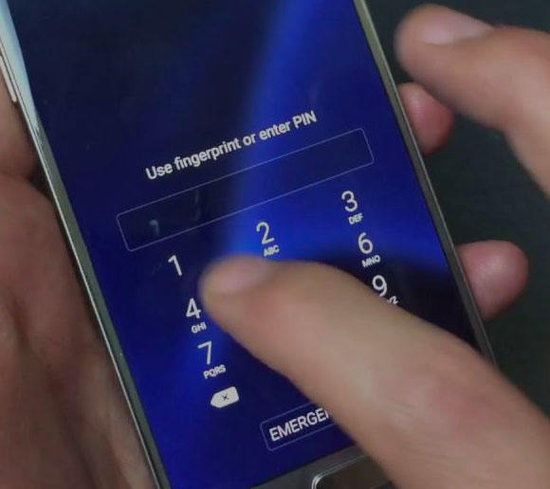

Where we are using Decision Making?

Slide 4
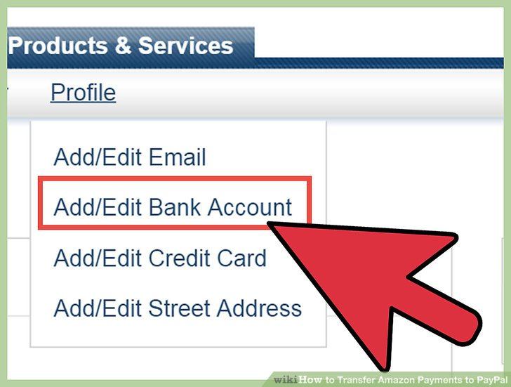

Where we are using Decision Making

Slide 5
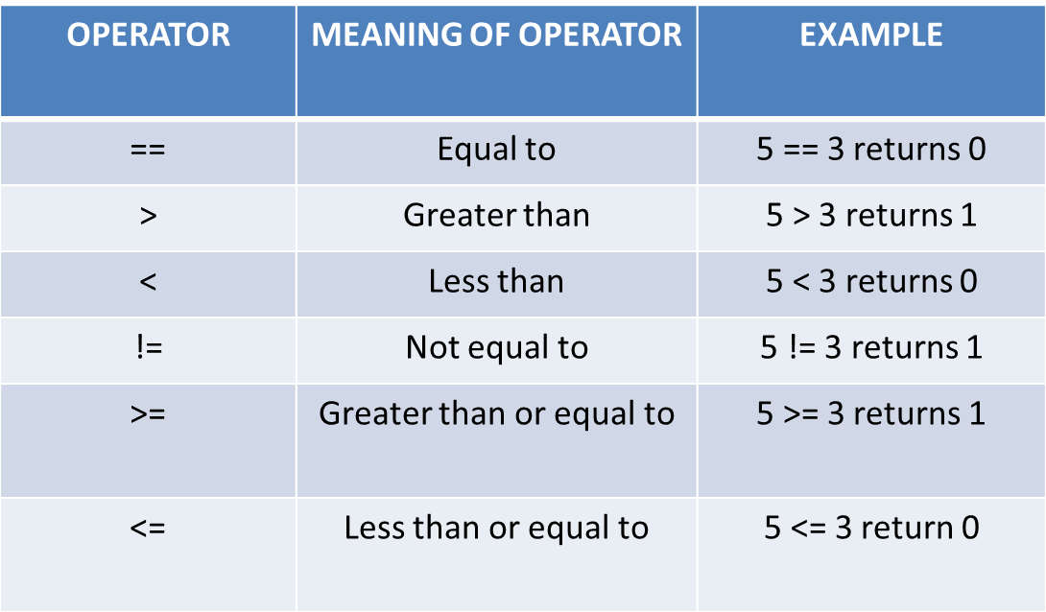
Conditions
Conditions are formed by relational operators.

Slide 6
Types
if – else
Cascaded(if else - if)
Nested if
Switch case

Slide 7
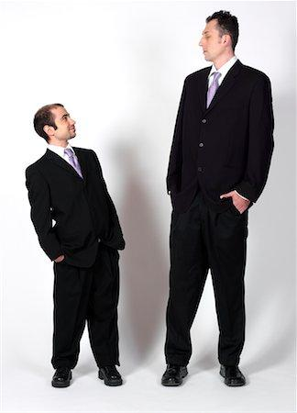
Who is taller?
How will you find it?
By comparing
How to do that in programming?
Using relational operators
Notes:
Title + Image + Text

Slide 8
Pseudocode
>
<
If(height of person 1 > height of person 2){
Print(“Person 1 is taller”)
}
Else{
Printf(“Person 2 is taller”)
}
If(height of person 1 < height of person 2){
Print(“Person 2 is taller”)
}
Else{
Printf(“Person 1 is taller”)
}
Notes:
Title + Image + Text

Slide 9
if – else statement
Syntax:
if(condition){
//code to be executed if condition is true
}
else{
//code to be executed if condition is false
}

Slide 10
Code
1
2
3
4
5
6
7
8
9
10
11
12
13
14
#include<stdio.h>
int main()
{
int h1, h2;
scanf(“%d”, &h1);
scanf(“%d”, &h2);
if( h1 > h2)
{
printf(“Person 1 is taller”);
}
else{
printf(“Person 2 is taller”);
}
}

Slide 11

Which one of the following condition(s) has to be satisfied to check if a person is eligible to donate blood?
A) Age > 18
B) Weight > 50
C) Both A and B
How will you write this in programming?
Using logical operators

Slide 12
Logical operators
Operators | Meaning
&& | AND
|| | OR
! | NOT

Slide 13
How to use logical operators in program?
If(age of person > 18) && (weight of person > 50 kg)
{
Print(“Eligible to donate blood”)
}
Else
{
Printf(“Not eligible”)
}
Notes:
Title + Image + Text

Slide 14
if – else statement
Syntax:
if(condition){
//code to be executed if condition is true
}
else{
//code to be executed if condition is false
}

Slide 15
Code
1
2
3
4
5
6
7
8
9
10
11
12
13
14
#include<stdio.h>
int main()
{
int age, weight;
scanf(“%d”, &age);
scanf(“%d”, &weight);
if(( age > 18) && (weight > 50))
{
printf(“Eligible to donate blood”);
}
else{
printf(“Not eligible”);
}
}

Slide 16

Who is taller?
How will you find it?
By comparing
How to do that in programming?

Slide 17
Demo
Notes:
Blank slide (Text Only)
Use this slide as an extension of other slides. Therefore, if the data doesn’t fit in any of the slides then put the extra data here.

Slide 18
Cascaded(if else-if)
Syntax:
if(condition1)
{
//code to be executed if condition1 is true
}else if(condition2)
{
//code to be executed if condition2 is true
}
else if(condition3){
//code to be executed if condition3 is true
}
...
else{
//code to be executed if all the conditions are false
}

Slide 19


Decision Making in PUBG
PUBG players are not going to get a Chicken Dinner anytime soon without the ability to aim at targets and take them down with relative ease. So to aim the target they must use scope. It can take hundreds of rounds before you become more comfortable with all the weapons on offer and start landing your shots, but we’re here to help speed that process up.
Conditions:
If you have 8x scope, Use snipper gun.
If you have 6X scope, Use AUG A3, GROZA, QBZ, M16A4, M416 .
If you have 4x Scope, Use UMP9, AKM, SCAR-L, Cross Bow .
If you have 2x Scope, almost all guns.
If you don’t have scope, find one.
Now Let’s help them by writing a program which helps them
to select the gun based on the scope .

Slide 20
Pseudocode
if(scope == 8)
{
Print(“Use Snipper”);
}
else if(scope == 6)
{
Print(“Use AUG A3 / GROZA / QBZ / M16A4 / M416 “);
}
else if(scope == 4)
{
Print(“Use UMP9 / AKM / SCAR-L / Cross Bow );
}
else if(scope == 2)
{
Print(“Almost all guns”);
}
else
{
Print(“Find one”);
}
Notes:
Title + Image + Text

Slide 21
Code
1
2
3
4
5
6
7
8
9
10
11
12
13
14
#include<stdio.h>
int main()
{
int scope;
scanf(“%d”, &scope);
if(scope == 8)
{
printf(“Use Snipper”);
}
else if(scope == 6){
printf(“Use AUG A3 / GROZA / QBZ / M16A4 / M416 “);
}

Slide 22
Code
15
16
17
18
19
20
21
22
23
24
25
26
27
14
else if(scope == 4)
{
printf(“Use UMP9 / AKM / SCAR-L / Cross Bow ”);
}
else if(scope == 2)(
printf(“Almost all guns”);
}
else{
printf(“Find one”);
}
}

Slide 23
Nested if
Syntax:
if (condition1)
{
// code to be executed if condition1 is true
if (condition2)
{
// code to be executed if condition2 is true
}
}

Slide 24

Bunjee Jumping
Have you tried or seen Bunjee Jumping ? It’s a weird experience, Isn’t it?.
But if someone is very eager to try bunjee jumping, they must satisfy few conditions
conditions:
Minimum Weight must be 40 kgs
Maximum Weight must be 110 kgs[If
Weight is greater than maximum, extra
ropes will be added]
3) Minimum age required is 12 years.
So if any person satisfying these criteria, Can enjoy
bunjee jumping.
Now we are going to write a program to check whether
the particular person is satisfying these criterias or not.

Slide 25
Pseudocode
If(age >= 12)
{
If(weight >= 40)
{
If(weight <= 110){
Print(“He can Jump”);
}
Else{
Print(“Extra ropes will be added”);
}
}
Else
{
Print(“He can’t Jump”);
}
}
Else
{
Print(“He can’t Jump”);
}
Notes:
Title + Image + Text

Slide 26
Code
1
2
3
4
5
6
7
8
9
10
11
12
13
14
#include<stdio.h>
int main()
{
int age, weight;
scanf(“%d”, &age);
scanf(“%d”, &weight);
if(age >= 12){
if(weight >= 40){
if(weight <= 110){
printf(“He can Jump”);
}
else{
printf(“Extra ropes will be added”);
}

Slide 27
Code
15
16
17
18
19
20
21
22
23
24
25
26
27
28
}
else{
printf(“He can’t Jump”);
}
}
else{
printf(“He can’t Jump”);
}
return 0;
}

Slide 28
Switch Case (Multiple Branching Statement)
Syntax:
switch(expression){
case 1:
//code to be executed;
break;
case 2:
//code to be executed;
break;
......
default:
code to be executed if all cases are not matched;
}

Slide 29
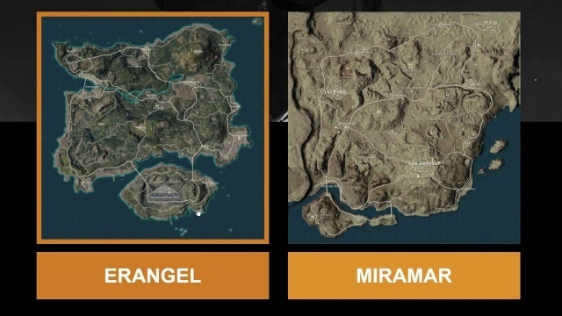


PUBG
Do you know how many maps are there in PUBG ?
Erangel [Forest]
Miramar[Desert]
Sanhok[Rain Forest]
Vikendi[Snow Forest]
When user enters the corresponding number of maps [1, 2, 3, 4].
It must get into that map, show a Welcome message and
displays the type of that map [Forest, Desert, Rain Forest, Snow Forest].
Use Switch Case.
Switch case is a multiple-branching statement

Slide 30
Pseudocode
Switch(number)
{
case 1:
Print(“Welcome to Erangel Map. You are Inside a Forest”);
break;
case 2:
Print(“Welcome to Miramar Map. You are Inside a Desert”);
break;
case 3:
Print(“Welcome to Sanhok Map. You are Inside a Rain Forest”);
break;
case 4:
Print(“Welcome to Vikendi Map. You are Inside a Snow Forest”);
break;
Default:
Print(“Invalid Input”);
}
Notes:
Title + Image + Text

Slide 31
Code
1
2
3
4
5
6
7
8
9
10
11
12
13
14
#include<stdio.h>
int main()
{
int number;
scanf(“%d”, &number);2
switch(number){
case 1:
printf(“Welcome to Erangel Map. You are Inside a Forest”);
break;
case 2:
printf(“Welcome to Miramar Map. You are Inside a Desert”);
break;

Slide 32
Code
15
16
17
18
19
20
21
22
23
24
25
26
27
28
case 3:
printf(“Welcome to Sanhok Map. You are Inside a Rain Forest”);
break;
case 4:
printf(“Welcome to Vikendi Map. You are Inside a Snow Forest”);
break;
}
return 0;
}

Slide 33

Switch Case (Fall through)
Syntax:
switch(expression){
case 1:
case 2:
case 3:
// Code to be executed
break
case 4:
case 5:
case 6:
// Code to be executed
break
}

Slide 34
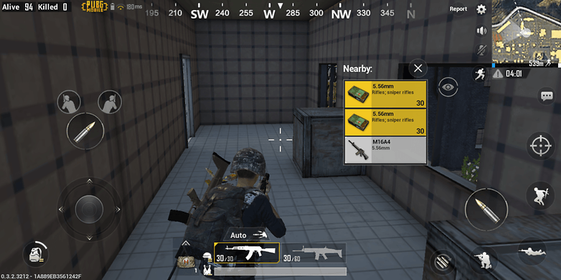
PUBG
After selecting the map in PUBG, the next steps are common in all the maps. Let’s take a look at the steps.
Selecting an area to drop out.
Looting weapons and equipments.
Stay out of blue circle.
Kill your enemies.
So, for all the four maps, we are going to
display these instructions.
So How will you do that ?

Slide 35
Pseudocode
Switch(number)
{
case 1:
case 2:
case 3:
case 4:
Print(“1.Selecting an area to drop out. \n2.Looting weapons and equipments.\n3.Stay out of blue circle.\n4.Kill your enemies.”);
break;
}
Notes:
Title + Image + Text

Slide 36
Code
1
2
3
4
5
6
7
8
9
10
11
12
13
14
#include<stdio.h>
int main()
{
int number;
scanf(“%d”, &number);
switch(number){
case 1:
case 2:
case 3:
case 4:
printf(“1.Selecting an area to drop out.
\n2.Looting weapons and equipments.
\n3.Stay out of blue circle.
\n4.Kill your enemies.”);

Slide 37
Code
15
16
17
18
19
20
21
22
23
24
25
26
27
28
break;
}
return 0;
}

Slide 38

THANK YOU
Notes:
Thank you slide

